Slide 1

April 2020 Meetup
@ Microsoft Teams Meeting

Slide 2

DISCLAIMER
Our views are of our own and not of our employers!
This event is not affiliated with Microsoft!

Slide 3
DIVERSITY CHARTER
We believe that all members of the technical community are equally important.
We are part a tech community where we value a diverse network, and learn and share from one another:
regardless of age,
regardless of colour,
regardless of their ethnicity,
regardless of their religion or beliefs,
regardless of disability,
regardless of gender,
regardless of sexual orientation,
regardless of their race,
regardless of their ability or lack of ability,
regardless of nationality or accent.
We are a diverse tech community where we are all individuals with differences, but we are all members and we can all learn from each other.

Slide 4
WELCOME
The 11th Sussex Azure User Group Meetup
Who are we…? (for the newcomers)
What is this all about…? (for the newcomers)
How did we get here…? (for the newcomers)
Future sessions & plans for the group
Tonight’s Agenda:
- Azure Exams & Certifications Discussion
- Presented by Jack, Ryan & Paul Grimley from Microsoft

Slide 5
Azure Exams & Certifications With Jack Tracey – Cloud Solution Architect @ Microsoft Ryan Littlemore – Azure Infrastructure Specialist @ Microsoft Paul Grimley – Cloud Solution Architect @ Microsoft

Slide 6
WHY?
What's the point?
What impact will it have on my career?
Potentially increased/higher salary
Good targets to set for 1-2-1’s at work
- Especially if they pay for your study & exam!

Slide 7
EXAM PATHS
What exam/path should you choose?
What do you want to learn? – need to enjoy it!
Take a free Azure Exam Self Assessment from 2 MVPs:
build5nines.com/free-oss-exam-self-assessment-tool
aka.ms/TrainCertPoster

Slide 8


Microsoft Certifications
*exam in beta **beta exams coming soon
^exam refresh coming soon
Role-based
Technical skills required to perform a job
Azure
Specialty
Deep technical skills managing industry solutions
Modern Workplace
Business Applications
(Apps & Infra)
(Data & AI)
Azure Solutions Architect^
Microsoft 365 Enterprise Administrator
Power Apps + Dynamics 365 Solution Architect*
Azure for SAP Workloads
Azure DevOps Engineer
Dynamics 365: Finance and Operations Apps Solution Architect*
Azure IoT Developer*
Expert
Associate
Azure Administrator^
Azure Data Scientist
Microsoft 365 Modern Desktop Administrator
Dynamics 365 Sales Functional Consultant
Dynamics 365 Customer Service Functional Consultant
Azure Developer*
Azure AI Engineer
Microsoft 365 Teamwork Administrator
Dynamics 365 Marketing Functional Consultant
Dynamics 365 Field Service Functional Consultant
Azure Security Engineer
Azure Data Engineer
Microsoft 365 Messaging Administrator
Dynamics 365 Finance Functional Consultant
Data Analyst**
Microsoft 365 Security Administrator
Dynamics 365 Supply Chain Management, Manufacturing Functional Consultant
Azure Database Administrator**
Dynamics 365 Supply Chain Management Functional Consultant
Microsoft 365 Teams Administrator
Power Apps + Dynamics 365 Developer
Microsoft 365 Developer
Dynamics 365: Finance and Operations Apps Developer*
Fundamentals
Foundational understanding of technology
Azure Fundamentals
Microsoft 365 Fundamentals
Dynamics 365 Fundamentals*
Power Platform Fundamentals
Notes:
These are the certifications we have released to meet market needs.
All our certifications prove that a person has the skills to help organizations maximize the capabilities of the cloud to achieve desired business outcomes.
We update our certifications regularly to reflect the change of pace of business and technology. Our certifications remain technically accurate and relevant, with updates occurring every two months, and additional roles and specialties added as the market requires.
So, how do you leverage all the resources available and set your team on a learning journey?

Slide 9
TEST CENTRE OR REMOTE
Where should you take the exam?
First, set a date!
Exam packages/deals:
- Exam Replay
- Exam Replay + Practice Test
- Ignite & Ignite The Tour Exam Vouchers For All Attendees

Slide 10
STUDYING
Where do you start?
Resources available to help you study?
Committing time to study – Before/After Work
Getting hands on with Azure directly
Practice exams – worth it?

Slide 11
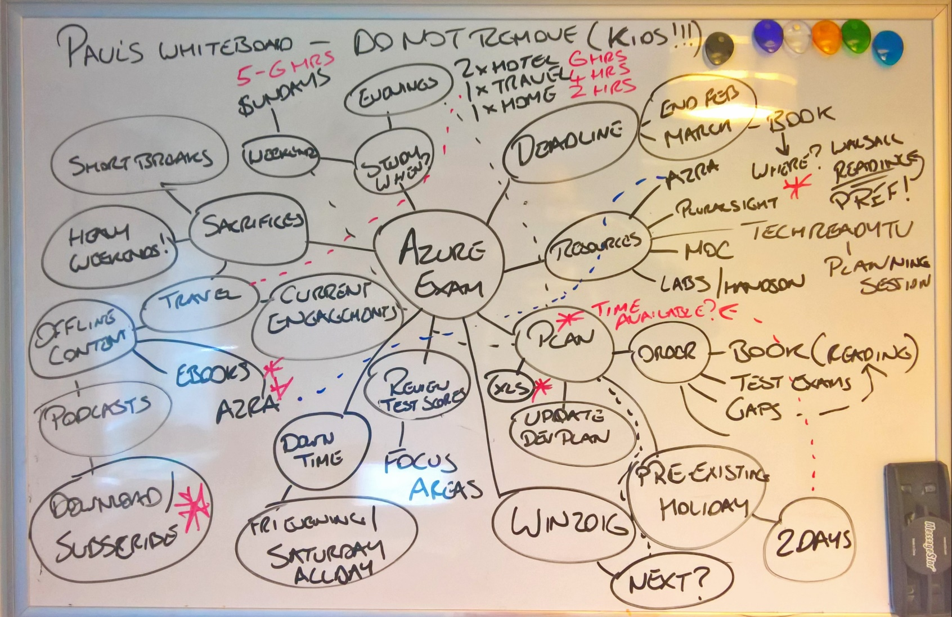
PAUL’S MINDMAP

Slide 12
STUDY RESOURCES
Microsoft Learn – aka.ms/learn
Pluralsight – pluralsight.com
Udemy – udemy.com
Skylines Academy – skylinesacademy.com
edX – edx.org
Measureup – measureup.com
Microsoft Partner Training – partner.microsoft.com/en-gb/training/assets#/?type=Exam
#AzureFamily Blogs & #CloudFamily – cloudfamily.info/blogs/azure_blogs

Slide 13
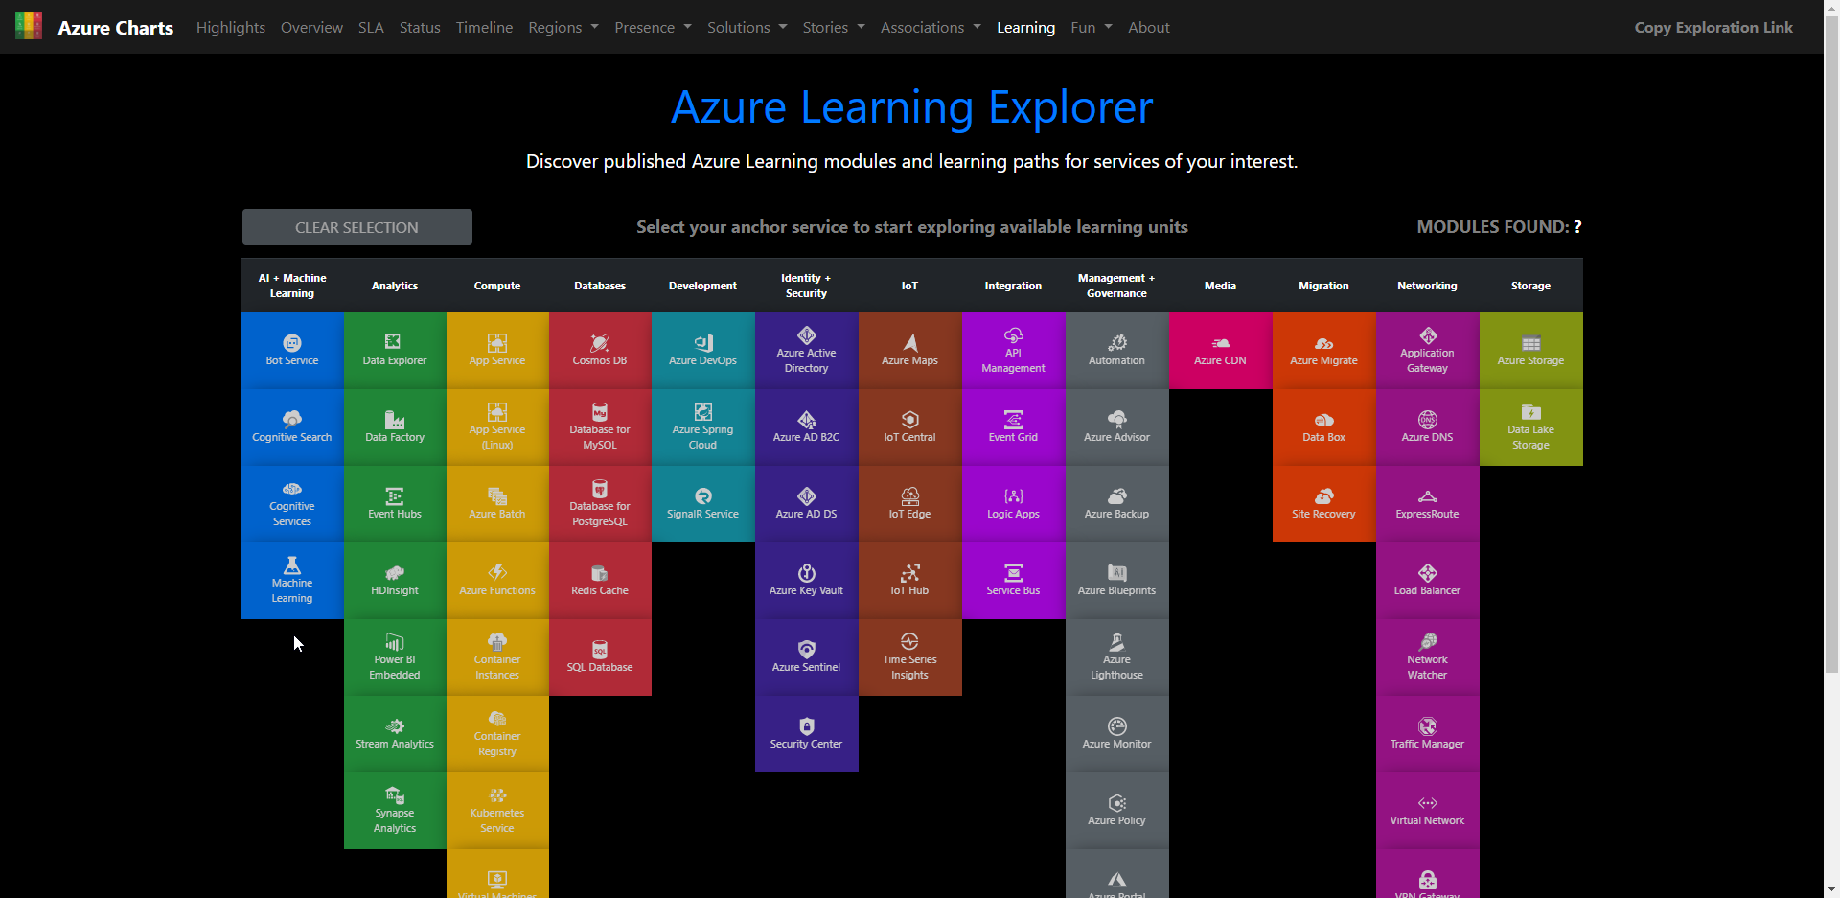
AZURE LEARNING EXPLORER
azurecharts.com/learning

Slide 14
WHAT IF I FAIL?
Don’t see it as a negative
Treat it as a positive thing, experience gained etc.
Get straight back on the horse – book the re-take ASAP
Utilise Exam Replay offer

Slide 15

QUESTIONS?

Slide 16

NEXT MEET UP
Stay tuned to our social feeds and YouTube channel!
sussexazure.uk/youtube

Slide 17
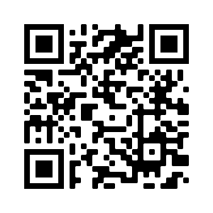





THANK YOU
Please give us your feedback, we really do read this!
https://sussexazure.uk/april20review
jacktracey.co.uk
sussexazure.uk
@jack_ref
sussexazure.uk/ryan
@SussexAzure
jtracey93
@ryan_littlemore
SussexAzure
sussexazure.uk/jack

